Slide 1


Power Supply Management
Submitted by
Amit Kumar

Slide 2
Objectives
Learn power requirement of each instrument
Power provided by Beagle bone Black Wireless
Sleep mode in Beagle bone Black
References

Slide 3
Components on transmitter side
Beagle bone black wireless
Xbee S2C module
Nextion Display 4.3’

Slide 4
Components at receiver side
Beagle bone black wireless
MQ2 Sensor
MQ9 Sensor
20*4 LCD display
Xbee S2C module
LM35 Temperature Sensor
NodeMCU ESP8266
MCT2E optocoupler
12V DC fan

Slide 5

Power supply for BBBW
Voltage Required 5V DC
Current 2A (max) through power adapter
Current 500 mA through USB cable

Slide 6
Beagle Bone Black Wireless
Devices functional modes
OFF State
Active State
Sleep State
Reset State

Slide 7
Modes of BBBW
OFF state :- In the OFF state, the PMIC is completely shut down with the exception of a few circuits to monitor the voltage on the AC, USB, and PB_IN pins. All output power rails are turned off and the registers are reset to their default values. The I2C communication interface is turned off.
To exit the OFF state, one of the following wake-up events must occur:
• The PB_IN pin is pulled low.
• The USB supply is connected (positive edge).
• The AC adapter is connected (positive edge).

Slide 8
Device Modes
Active State
This state is the typical mode of operation when the system is up and running. All DC/DC converters, LDO regulators, load switches, the WLED driver, and the battery charger are operational and can be controlled through the I2C interface.
The PWR_EN pin must be pulled low for the device to go from ACTIVE state.

Slide 9
Device Modes
SLEEP state
The SLEEP state is a low-power mode of operation intended to support system standby. Typically, all power rails are turned off with the exception of the LDO1 rail, and the registers are reset to their default values. The LDO1 rail stays operational but can support only a limited amount of current (1 mA typical).
The device goes to the ACTIVE state after detecting a wake-up event as described in the previous sections.

Slide 10
Devices mode
Reset state
The device can be reset by either pulling the nRESET pin low or by holding the PB_IN pin low for more than 8 s. All rails are shut down by the sequencer and all register values are reset to their default values. Rails not controlled by the sequencer are shut down after the power-down sequencer is complete. The device stays in the this state for as long as the reset pin is held low, and the nRESET pin must be high for the device to go from the RESET state.

Slide 11
Commands for sleep mode
Different types of commands can be used to put BBBW in sleep mode
echo mem > /sys/power/state
rtcwake -s 90 -m mem -d /dev/rtc0
cd bbbrtc
make i2cset -f -y 0 0x24 0x0a 0x00
bbbrtc wake 170
bbbrtc sleep 110
sync
bbbrtc now 100

Slide 12
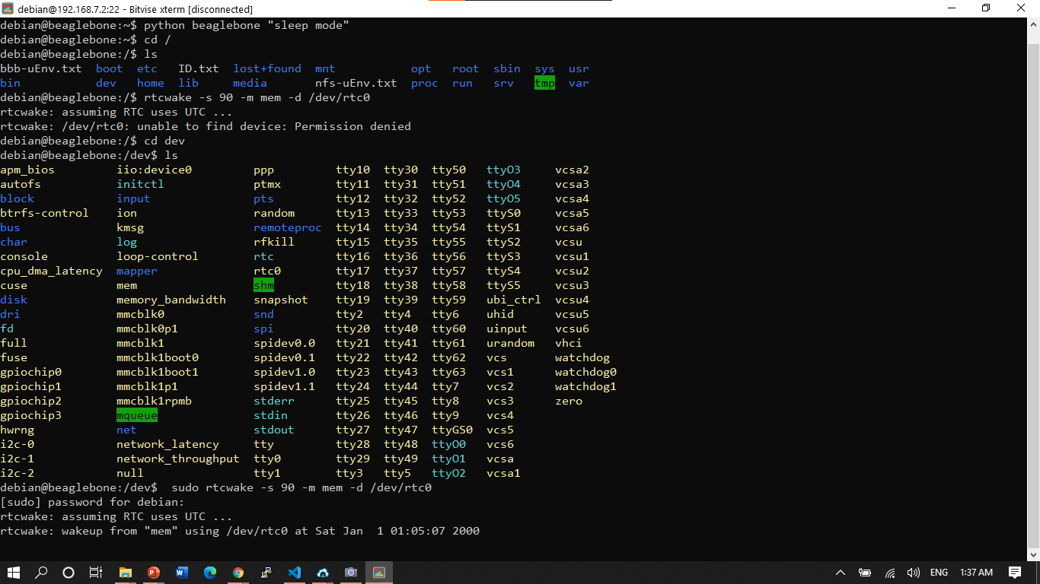

Slide 13
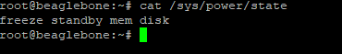
States by BBBW
Freeze
Standby
Mem
Disk

Slide 14
Code
#include <iostream>
#include <unistd.h>
using namespace std;
int main()
{
cout << "system going for sleep for 20 sec"<< endl;
system("sudo rtcwake -d /dev/rtc0 -m standby -s 20"); // putting system to sleep for 20 sec
return 0;
}

Slide 15
States of BBBW
Standby - ACPI state S1. This state offers minimal, though real, power savings, while providing a very low-latency transition back to a working system. This is the default mode.
Freeze - The processes are frozen, all the devices are suspended and all the processors idled. This state is a general state that does not need any platform-specific support, but it saves less power than Suspend-to-RAM, because the system is still in a running state. (Available since Linux 3.9.)
Mem - ACPI state S3 (Suspend-to-RAM). This state offers significant power savings as everything in the system is put into a low-power state, except for memory, which is placed in self-refresh mode to retain its contents.
Disk - ACPI state S4 (Suspend-to-disk). This state offers the greatest power savings, and can be used even in the absence of low-level platform support for power management. This state operates similarly to Suspend-to-RAM, but includes a final step of writing memory contents to disk.

Slide 16
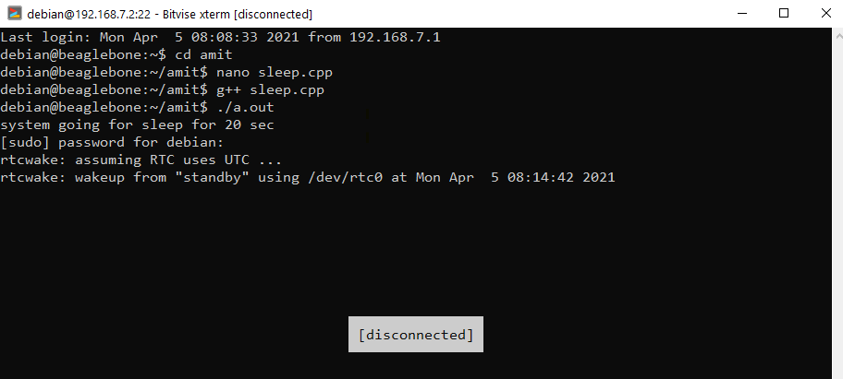

Slide 17
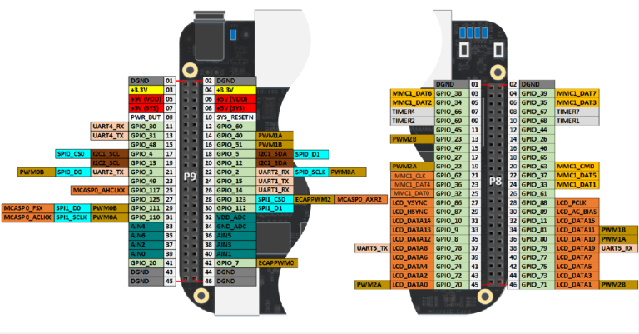
Pin configuration for BBBW

Slide 18
Output Power provided by BBBW
Power 5V VDD can provides upto 1000mA current Max
Power 5V sys can provide 250 mA current max
Power 3.3V can provide upto 250mA current max
VDD_ADC (1.8V) can provide 250mA
All I/O pins 3.3V can provide maximum 250mA
AIN pins 1.8V (small current should be drawn from these pins)

Slide 19
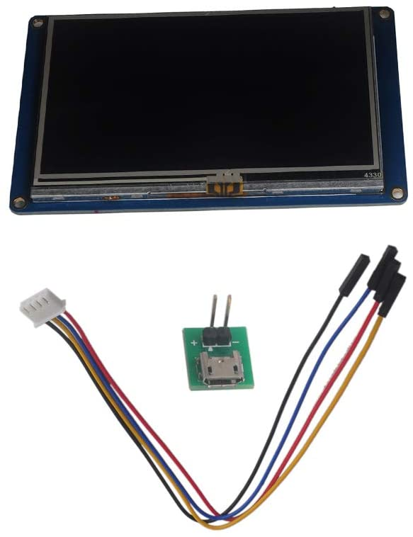
Nextion (NX4827T043) touch Display
Power Requirement for display
Additional power supply adapter
Voltage Current
5V 1-2A

Slide 20
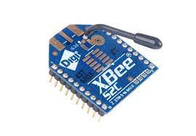
Power Requirement for XBEE S2C module
SUPPLY VOLTAGE 2.1 to 3.6 V
TRANSMIT CURRENT 33 mA @ 3.3 VDC / 45 mA boost mode
RECEIVE CURRENT 28 mA @ 3.3 VDC / 31 mA boost mode
POWER-DOWN CURRENT<1 μA @ 25º C (77º F)

Slide 21
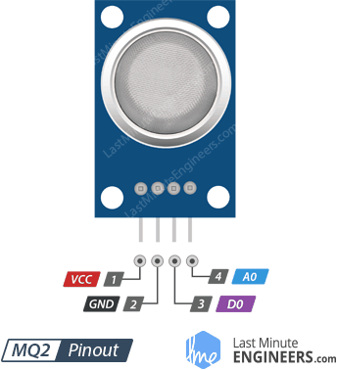
MQ2 sensor Power Requirements
Voltage required 5V
Heating Voltage 5V
Current required 200mA
Heating Consumption 800mW

Slide 22
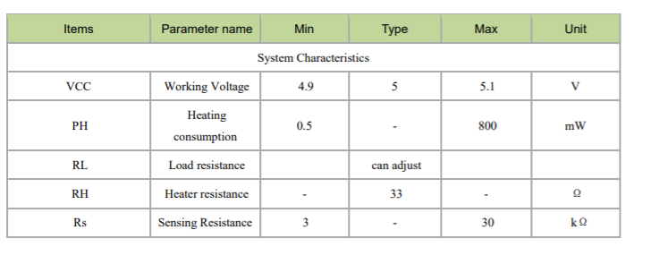
MQ2 Power Specification

Slide 23
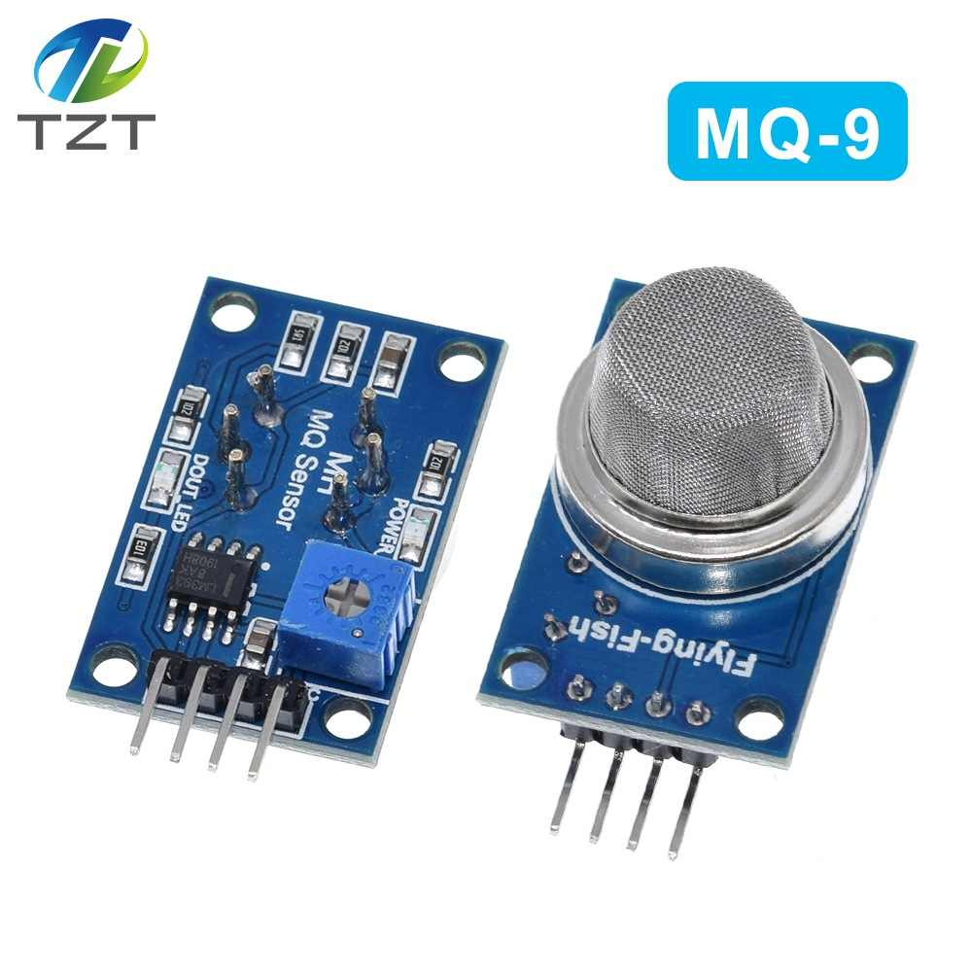
MQ9 Sensor Power Supply Requirement
They are used in gas detecting equipment for carbon monoxide and CH4, LPG in house, Industry and Car.

Slide 24
MQ9 power specification
Vc circuit voltage 5V±0.1 AC or DC
VH (H) Heating voltage (high) 5V±0.1 AC or DC
VH (L) Heating voltage (low) 1.4V±0.1 AC or DC
RL Load resistance Can adjust
RH Heating resistance 33Ω±5% Room temperature
TH (H) Heating time (high) 60±1 seconds
TH (L) Heating time (low) 90±1 seconds
Ps Heating consumption Less than 340mw

Slide 25
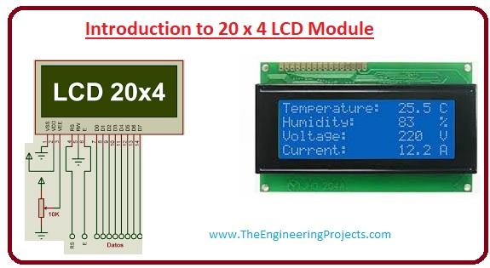
20*4 LCD

Slide 26
Pin No: | Pin Name: | Parameters
Pin#1 | It denoted as Vss | It is ground pinout potential at this pinout is zero.
Pin#2 | It denoted as Vdd | At this pinout, five volts are provided.
Pin#3 | This pinout denoted as Vo | This pinout is used to set the contrast of the screen.
Pin#4 | This pin denoted as RS | It used to H/L register select signal.
Pin#5 | It denoted as R/W | It used for H/L read/write signal.
Pin#6 | This pinout denoted as E | It used for H/L enable signal.
Pin#7-14 | The pinouts from seven to fourteen denoted as DB0 – DB7. | It used for H/L data bus for 4 bit or 8-bit mode.
Pin#15 | It identified as A (LED+) | It used to set backlight anode.
Pin#16 | It recognized as K (LED-). | It used to set backlight cathode.

Slide 27
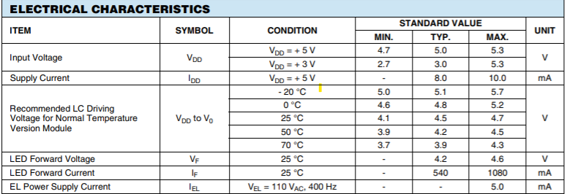
20*4 LCD power requirement

Slide 28
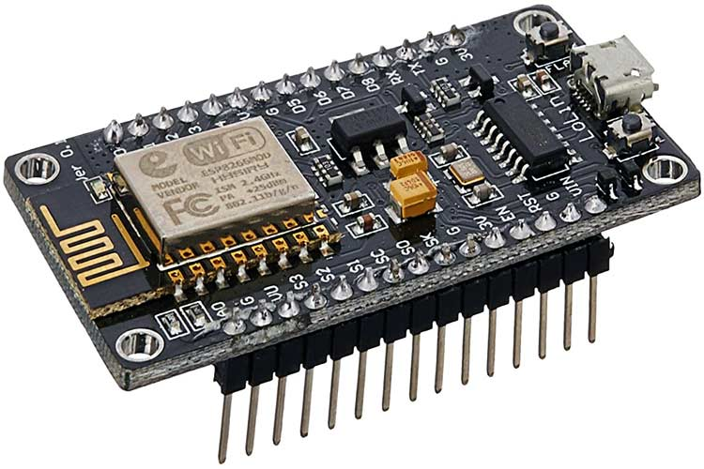
Node MCU ESP8266 Power requirement
NodeMCU is an open-source Lua based firmware and development board specially targeted for IoT based Applications. It includes firmware that runs on the ESP8266 Wi-Fi SoC from Espressif Systems, and hardware which is based on the ESP-12 module.

Slide 29
Pin Category | Name | Description
Power | Micro-USB, 3.3V, GND, Vin | Micro-USB: NodeMCU can be powered through the USB port 3.3V: Regulated 3.3V can be supplied to this pin to power the board GND: Ground pins Vin: External Power Supply
Control Pins | EN, RST | The pin and the button resets the microcontroller
Analog Pin | A0 | Used to measure analog voltage in the range of 0-3.3V
GPIO Pins | GPIO1 to GPIO16 | NodeMCU has 16 general purpose input-output pins on its board
SPI Pins | SD1, CMD, SD0, CLK | NodeMCU has four pins available for SPI communication.
UART Pins | TXD0, RXD0, TXD2, RXD2 | NodeMCU has two UART interfaces, UART0 (RXD0 & TXD0) and UART1 (RXD1 & TXD1). UART1 is used to upload the firmware/program.
I2C Pins |  | NodeMCU has I2C functionality support but due to the internal functionality of these pins, you have to find which pin is I2C.

Slide 30
Hardware Specifications
Operating Voltage: 2.5V ~ 3.6V
Operating Current: Average value: 80 mA
Operating Temperature Range: –40°C ~ 125°C
Package Size: QFN32-pin (5 mm x 5 mm)

Slide 31
Power management in NodeMCU
ESP8266EX is designed with advanced power management technologies and intended for mobile devices, wearable electronics and the Internet of Things applications. The low-power architecture operates in the following modes:
• Active mode: The chip radio is powered on. The chip can receive, transmit, or listen.
• Modem-sleep mode: The CPU is operational. The Wi-Fi and radio are disabled.
• Light-sleep mode: The CPU and all peripherals are paused. Any wake-up events
(MAC, host, RTC timer, or external interrupts) will wake up the chip.
• Deep-sleep mode: Only the RTC is operational and all other part of the chip are
powered off.

Slide 32
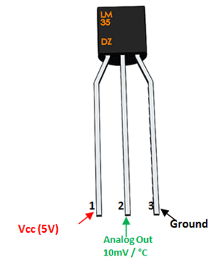
Temperature Sensor
Power the IC by applying a regulated voltage like +5V (VS) to the input pin and connected the ground pin to the ground of the circuit.
If the temperature is 0°C, then the output voltage will also be 0V. There will be rise of 0.01V (10mV) for every degree Celsius rise in temperature.

Slide 33
Pin Configuration
Pin Number | Pin Name | Description
1 | Vcc | Input voltage is +5V for typical applications
2 | Analog Out | There will be increase in 10mV for raise of every 1°C. Can range from -1V(-55°C) to 6V(150°C)
3 | Ground | Connected to ground of circuit

Slide 34
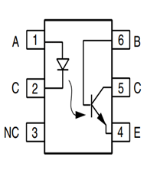
MCT2E Optocoupler
The digital signal given to the IR LED will be reflected on the transistor but there will be no hard electrical connection between the two.

Slide 35
MCT2E Optocoupler specification
Input Diode Forward Voltage: 1.25V
Collector-Emitter Voltage: <30V
On-State Collector Current: 5mA
Transistor HFE: 300
Rise Time: 5us
Fall Time: 5us
Available as 6-pin PDIP with and without M-suffix

Slide 36
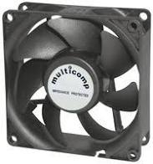
DC fan
Fan Size: 120x120x25mm
RPM: 3000 +/- 10%
Rated Current: 0.36 Amp Running / 0.6 Amp Startup
Airflow: 105 CFM
Noise: 42 dB
Rated Voltage: 12 V DC
Bearing Type: Ball Bearing

Slide 37
References
Nextion
https://www.amazon.ca/gp/product/B07B9XTSWH/ref=ppx_od_dt_b_asin_title_s00?ie=UTF8&psc=1
Xbee
https://www.digi.com/resources/library/data-sheets/ds_xbee-s2c-802-15-4
Beagle bone Black
https://e2e.ti.com/support/processors/f/processors-forum/274073/need-help-with-rtcwake
https://cdn-shop.adafruit.com/datasheets/BBB_SRM.pdf

Slide 38
References
MQ2 sensor
http://gas-sensor.ru/pdf/combustible-gas-sensor.pdf
MQ9 sensor
https://www.electronicoscaldas.com/datasheet/MQ-9_Hanwei.pdf
20*4 LCD
https://www.theengineeringprojects.com/2019/12/introduction-to-20-x-4-lcd-module.html

Slide 39
References
NodeMCU ESP8266
https://circuits4you.com/2019/01/13/esp8266-absolute-maximum-ratings/
MCT2E Optocoupler
https://components101.com/ics/mct2e-phototransistor-optocoupler-ic
LM 35 Temperature Sensor
https://components101.com/sensors/lm35-temperature-sensor#:~:text=LM35%20is%20a%20precession%20Integrated,C%20to%20150%C2%B0C.&text=There%20will%20be%20rise%20of,degree%20Celsius%20rise%20in%20temperature

Slide 40

Questions ?
THANKS

